Slide 1
Binary logic
And or not …

Slide 2
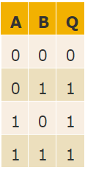
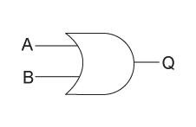
Or

Slide 3
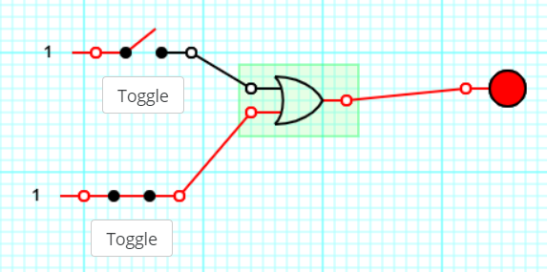
https://sciencedemos.org.uk/logic_gates.php

Slide 4
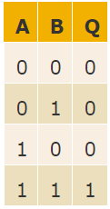
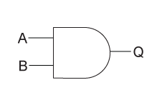
and

Slide 5

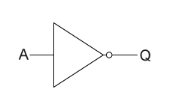
not

Slide 6
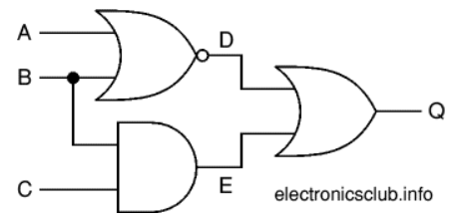
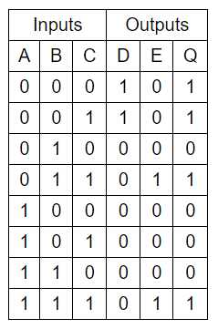


Slide 7
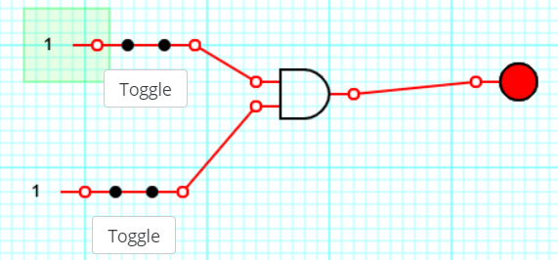
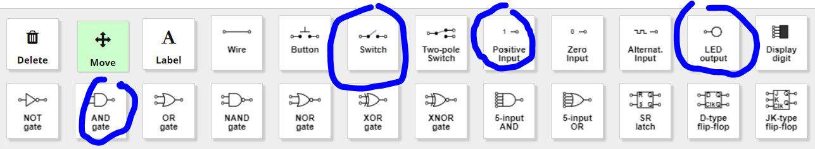
https://sciencedemos.org.uk/logic_gates.php
AND
OR
NOT
NAND
NOR
XOR

Slide 8
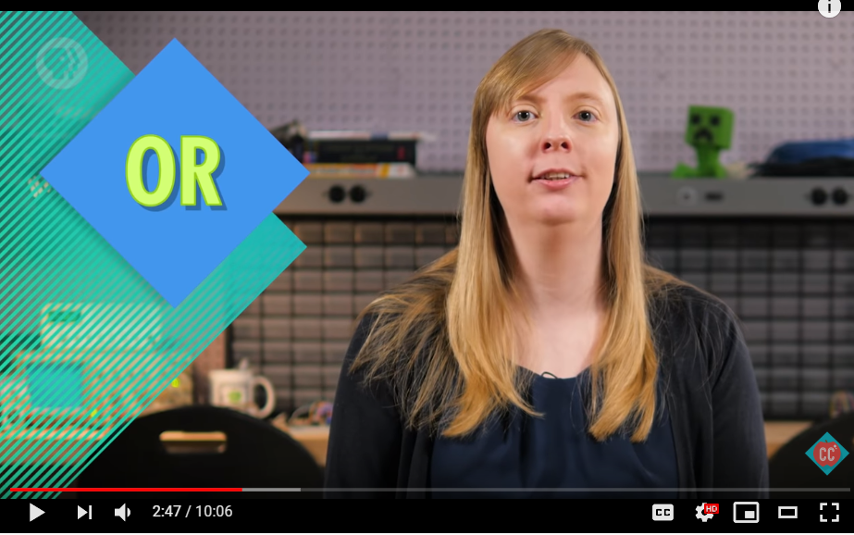
https://www.youtube.com/watch?v=gI-qXk7XojA

Slide 9
Truth tables
https://sciencedemos.org.uk/logic_gates.php
AND
OR
NOT
NAND
NOR
XOR
Draw it
Describe it
Logic gate truth table
worksheet

Slide 10
Binary addition
Write a document that describes binary addition
Make sure it has examples
What is overflow?

Slide 11
Binary to decimal converter
Binary to decimal
Decimal to binary

